Slide 1



SEMANTIC WEB
A vision to achieve “Machine Understandable Web”
Prepared By:
Pruthvirajsinh Sisodiya(1721BECE30160)
Deep Sherathiya(1721BECE153)
Dhruv Shekhat(1721BECE30152)
Dishank Sharma(1721BECE30150)
Guided By:
Prof. Dharmesh Tank

Slide 2
Content
Introduction
Architecture
Components of Semantic Web
Features
Conclusion

Slide 3
The Semantic Web
The word semantic stands for the meaning of. The semantic of something is the meaning of something
In a word, Semantic Web is: Next generation Web of data that is understandable by machines.
allow machines to understand the meaning of web.
It is an extension of web in which information is given well-defined meaning, better enabling computers and people to work in cooperation.

Slide 4
Current Web Vs Semantic Web
Current web
Semantic web
500 million user more than 3 billion pages
Serious Problem in Information
Finding
Extracting
Interpreting
Maintaining
Representing
WWW
URI,HTML,HTTP
WWW
URI,HTML,HTTP
Semantic Web
RDF,RDF(S),OWL
Static
Static

Slide 5
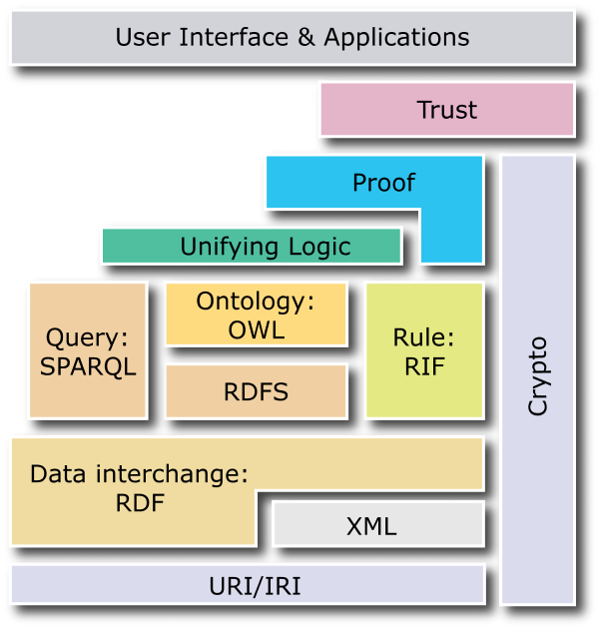
Semantic web Architecture
Machine-processable, global Web standards:
Assigning unambiguous names (URI)
Expressing data, including metadata (RDF)
Capturing ontologies (OWL)
Query, rules, transformations, deployment, application spaces, logic, proofs, trust (in progress)

Slide 6
Components of Semantic Web
Identifiers : Uniform Resource Identifier(URI)
Documents : Extensible Markup Language(XML)
Statements : Resource Description Framework(RDF)
Ontologies(OWL)
Proof
Logic
Trust

Slide 7
URI
Stand for Uniform Resource Identifier
To identify items on the Web, we use identifiers. Because we use a uniform system of identifiers, and because each item identified is considered a “resource“.
We can give a URI to anything, and anything that has a URI can be said to be “on the Web“.

Slide 8
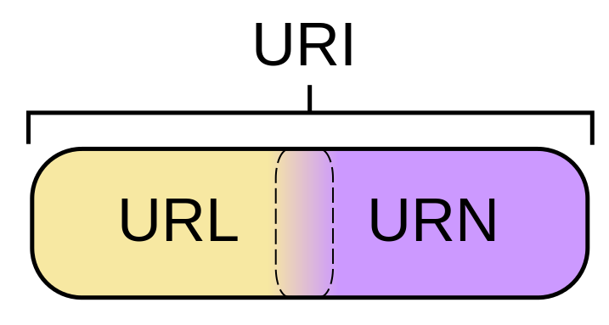
URI
A String of characters used to identify a name or a web resources
URN(Uniform Resource Name)
  Persistent, location-independent identifiers for resources
URL(Uniform Resource Locator)
  A means of locating the resources

Slide 9
XML
XML lets everyone to create their own tags.
These tags can be used by the script programs in sophisticated ways to perform various tasks.
XML allows you to add arbitrary structure to the documents.
It has no built mechanism to convey the meaning of the user’s new tags to other users.

Slide 10
XML Schema
XML schema provides similar service and add:
XML schemas definition are itself XML documents
XML schemas provide a rich set of datatypes that can be used to define the values of elementary tags
XML schemas provide much richer means for defining nested tags (such as tags with subtags)
XML schemas provide the namespace mechanism to combine XML documents with heterogeneous vocabulary

Slide 11
RDF
Stand for Resource Description Framework
A schema for defining information on the web.
Markup language for describing information and resources.
RDF encodes information on the XML page in sets of triples.
triple is a combination of subject , verb and object similar to an elementary sentence.
It is designed to be read and understood by computers.
RDF provides metadata about web resources.

Slide 12
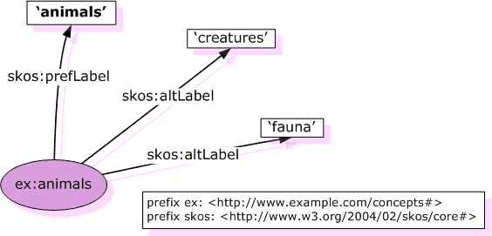
RDF Example
Source: http://www.w3.org/TR/swbp-skos-core-guide/

Slide 13
OWL(ontology)
an ontology is a formal, explicit specification of a shared conceptualization – Gruber
A formal specification that provides sharable and reusable knowledge representation
Main Components of Ontology:
Classes
Relations
Functions
Axioms
Instances

Slide 14
OWL
Knowledge Representation ontologies
    capture the representation primitives used to formalize knowledge in KR paradigm
    such as: Frame-Ontology
General/Common ontologies
    vocabulary related to things, events, time, space, etc.
    such as: meter and inch exchange table
Meta-ontologies
    reusable across domains
    such as: mereology ontology (Borst, 97)

Slide 15
OWL
Application:
    Knowledge Management
    Enterprise Application Integration
    E – Commerce
    used in many applications to capture relationships and boost knowledge management.
    early hypotheses testing in Pharma
    fraud detection
    semantic web mining

Slide 16
Proof
Once we begin to build systems that follow logic, it makes sense to use them to prove things.
People all around the world could write logic statements. Then your machine could follow these Semantic "links" to construct proofs.
The proofs created are the signs of success of a semantic web because that’s signals the creation of new knowledge by the machine on its own.

Slide 17
Logic
For the Semantic Web to become expressive enough to help us in a wide range of situations, it will become necessary to construct a powerful logical language for making inferences
It calls for a way to represent data in a machine readable logical format using appropriate predicates like ‘and’ , ‘or’ etc.
In Semantic web, types of Logic:
  Common Logics
  Description Logics

Slide 18
Trust
Digital Signatures and web of trust.
Now since we have machines being able to create knowledge based on the logic supplied to them we have to make sure that the supplied logic is trustworthy.
That's where Digital Signatures come in. We can have a universal signing system just like we have today but with a slight modification- the signature is given for the logical accuracy of the data.
It’s the most difficult step because of the massive chunks of data we already have and the huge data inflow we have everyday.

Slide 19
Semantic Web Content: New “User”
Applications
Agents

Slide 20
Features
Searches
Agents
Knowledge management
Integration
Virtual community
Online advertising
Multimedia collection
Information Filtering

Slide 21
Conclusion
The semantic web is not as complex as people believe
The semantic web doesn’t require huge investments before seeing its value
Don’t forget privacy: set usage guidelines to safeguard privacy
Don’t expect perfection: they’re far from perfect
Don’t be impatient: there must be a multiyear commitment to have any hope of success

Slide 22
Thank You!

